Slide 1
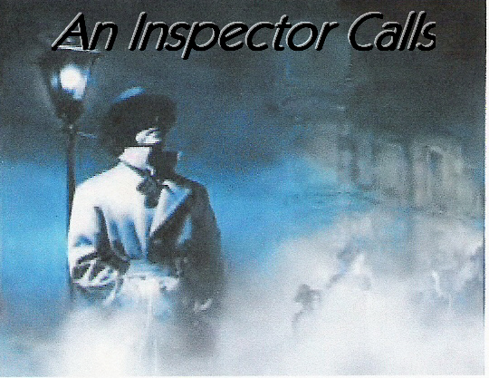
Inspector Goole

Slide 2
Connector
Write down the connotations of the word ‘Goole’
Think about –
The sound?
Homonyms?

Slide 3
Today’s lesson objectives are:
To understand the role and nature of the Inspector.
To recognise how the Inspector is used by Priestley to convey social inequality.
To recognise how Priestley uses language to make the Inspector’s character more effective.

Slide 4
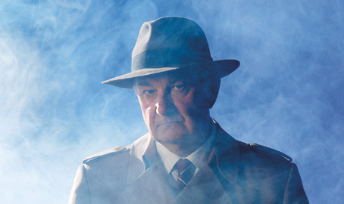
Inspector Goole
His name sounds like ‘ghoul’ – a spirit said to take fresh life from corpses.
He creates an “impression of massiveness, solidity and purposefulness”
Goole is also a seaport town and could suggest he is going to fish for information.
He is in his fifties and dressed in a “plain darkish suit of the time”
“He speaks carefully, weightily and has a disconcerting habit of looking hard at the person he addresses”

Slide 5
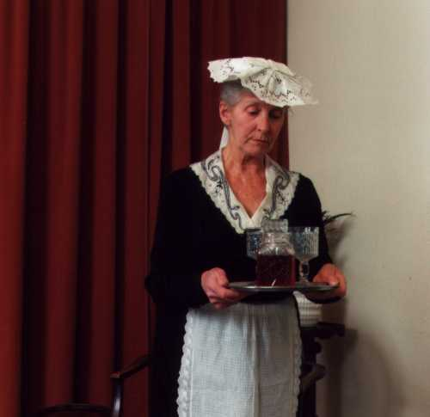
An Inspector Calls
Edna announces that “an Inspector’s
called”
The word ‘calls’ sounds casual as if it
is an informal chat – but it’s quite the
opposite.
The word is deceptive. The Inspector
is single-minded and calculating.
So, the title of the play is echoed
in the parlourmaid’s words.

Slide 6
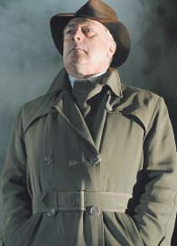
The Inspector is: in control?
He controls the rate at which the revelations tumble out.
He slows the pace down (looking from one character to another) and speeds things up he turns ‘sharply’ on Mrs Birling.
He cuts into the dialogue “with authority” telling Mr Birling that Eric must wait his turn.
He ‘massively’ interrupts Birling and comes close to shouting at him when he tells him not to “stammer” and “yammer”

Slide 7
The Inspector is: successful?
He answers his own questions if he’s not happy with the answer he gets. “You know very well there was Mrs Birling. You were in the chair”
He repeats a question if the answer isn’t good enough. “was it or was it not your influence?”
He’s persistent. He follows up questions with more questions so as to draw out a confession.
He asks very personal questions. For example he asks Gerald if he loved Daisy Renton.
He can be aggressive but it works. He manages to trap them and draws information out before anyone really understands what’s going on.

Slide 8
A Police inspector
Listens to confessions
Interrogates suspects
Sounds like an Inspector – I’m on duty
A whodunit detective
Has evidence – Eva Smith’s diary
Has the victim’s photograph
Is not put off by threats
Is dedicated and relentless

Slide 9
A Mystery
He could be a ghost (ghoul) or an avenging angel.
He could represent a religious figure representing morality and a moral stance.
Morality plays were religious plays written in the Middle Ages.
They involved the seven deadly sins and tried to teach people how to behave.
The Inspector preaches a secular moral lesson.

Slide 10
A Catalyst
A character who makes things happen
He exposes what is behind the family’s respectable facade
He reveals the characters to one another
He disturbs the apparent tranquillity of their lives
He leaves the house unchanged despite the massive reactions he has caused
The younger generation will be better people because of him

Slide 11
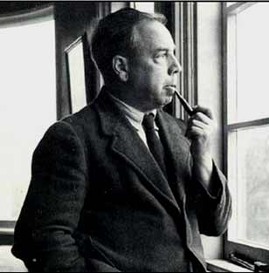
A Mouthpiece for the Author
Priestley was a socialist
who despised capitalism.
The Inspector represents Priestley’s strong moral views. He demonstrates how people are responsible for how they affect the lives of others.
He sees the world as a community where everyone should be helping each other.
“We are members of one body”

Slide 12
A character in a play
In theatrical terms he is a character who belongs to a different dimension to the others.
He doesn’t conform to any of the Birlings’ ideas about class.
He acts as an omniscient narrator, filling in the gaps of Eva’s life.
He doesn’t follow any rules of etiquette.

Slide 13
The Inspector’s Language
Inspector Goole has come into the house to stir things up – to get a reaction. One way of doing this is to stir up his listeners with emotive language.
He describes Eva as a ‘pretty’ girl who died in ‘misery and agony’.
He says she was ‘alone, friendless, almost penniless, desperate’.
He declares that if “men will not learn that lesson, then they will be taught it in fire and blood and anguish”

Slide 14
Today’s lesson objectives were:
To understand the role and nature of the Inspector.
To recognise how the Inspector is used by Priestley to convey social inequality.
To recognise how Priestley uses language to make the Inspector’s character more effective.

